Slide 1

National University of Computer and Emerging Sciences
Attention is All you Need (Transformers)
CS-4025: Deep Learning for Perception
Dr. Noshina Tariq
Department of AI and DS

Slide 2
Goals
Today’s Lecture
Attention is All you Need (Transformers)

Slide 3
Introduction
Sequence transduction models are based on complex recurrent or convolutional neural networks
An encoder and a decoder.
However, the model called Transformer, is based solely on attention mechanisms
No need for recurrence and convolutions entirely.
Transformer-based models are superior in quality and can process in a more parallel way
Require less training time.

Slide 4
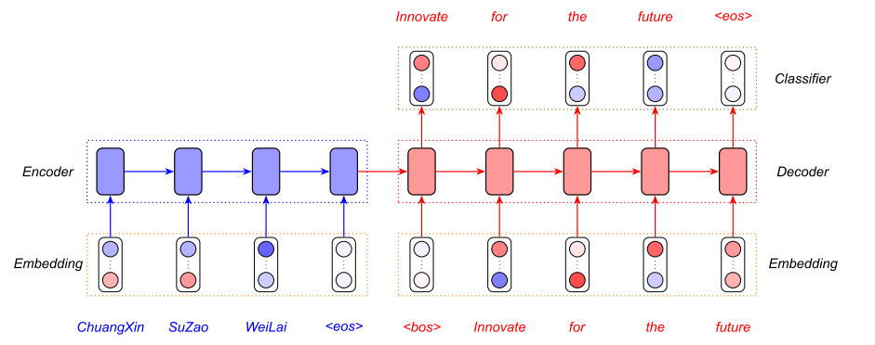
Introduction
Sequence transduction
https://www.analyticsvidhya.com/

Slide 5
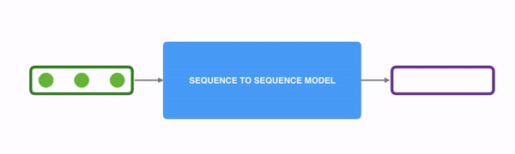
Introduction
State of the art models for Sequence modeling and transduction problems :
Recurrent neural networks, long short-term memory and gated recurrent neural networks
Example: Language modeling and machine translation
Can we expand boundaries of recurrent language models and encoder-decoder architectures?
towardsdatascience.com

Slide 6
Introduction
Examples of sequence transduction problems:
1. Machine Translation
2. Speech Recognition
3. Speech Synthesis (Text-to-Speech)
4. Video Captioning

Slide 7
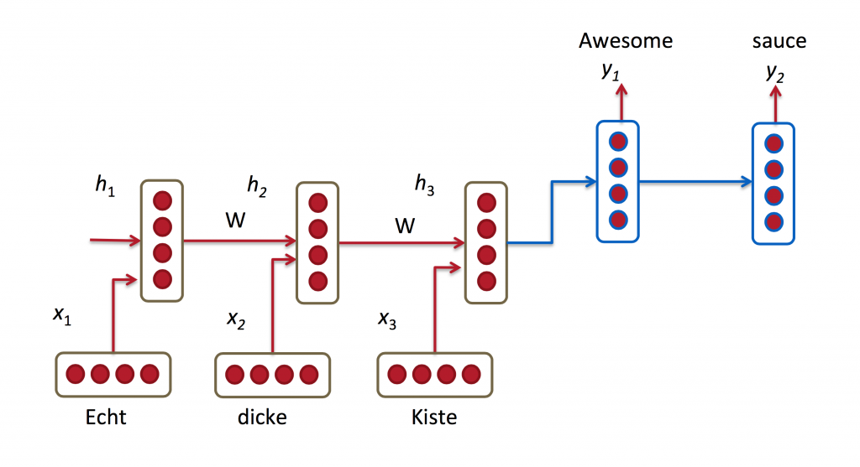
Introduction
Recurrent models typically take input in sequence and generate output sequences.
Generate a sequence of hidden states h_{t}, as a function of the previous hidden state h_{t−1} and the input for position t.
Stanford lectures: CS224d

Slide 8
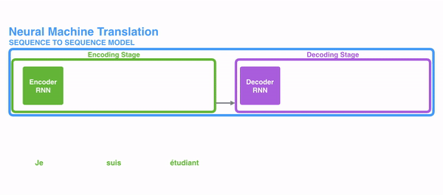
Introduction
Sequential nature prohibits parallelization within training examples
Critical at longer sequence lengths and memory constraints limit batching across examples.
More difficult to learn longer dependencies between inputs.
Some suggested improvements for computational efficiency:
Factorization tricks
Conditional computation
Still constraint of sequential computation
remains.

Slide 9
Introduction to Transformer
A transformer model is a type of deep learning model that was introduced in 2017.
These models have become fundamental in natural language processing (NLP).
Proposed in 2017 in a paper titled: "Attention is All You Need" by team at Google Brain, and the University of Toronto.
Transformer is the first transduction model relying entirely on self-attention to compute representations of its input and output without using RNNs or convolution.

Slide 10
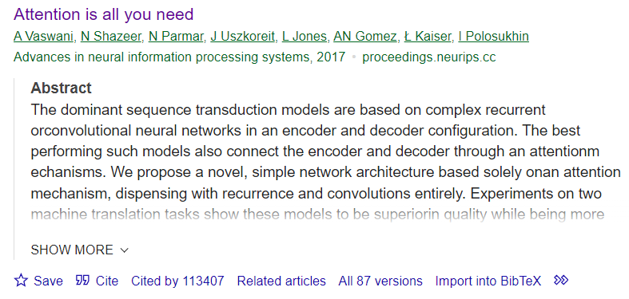
Introduction to Transformers
Download Paper:

Slide 11
Introduction to Transformer
It is an attention-layer-based, sequence-to-sequence (“Seq2Seq”) encoder-decoder architecture.
Transformer models have emerged as a groundbreaking approach to various language-related tasks.
Some well-known models based on the Transformer architecture:
BERT (Bidirectional Encoder Representations from Transformers): Google
GPT (Generative Pre-trained Transformer): OpenAI
T5 (Text-To-Text Transfer Transformer): Google
RoBERTa (Robustly optimized BERT approach):Facebook AI
BART (Bidirectional and Auto-Regressive Transformers): Facebook AI
DistilBERT: Hugging Face

Slide 12
Introduction to Transformer
Attention:
It is referred to as "global" or "soft" attention
Attention is a mechanism that allows the model to focus on relevant parts of the input sequence.
It assigns weights to different elements in the input sequence, indicating their importance or relevance to the specific context or query.
These weights are usually computed based on the similarity between the current input element and all other elements in the sequence.
The weighted sum of the input elements is calculated based on attention scores, which is used to generate the output.

Slide 13
Introduction to Transformer
Example:
When translating a sentence from one language to another, attention allows the model to focus on different words in the input sentence depending on the context and the word being translated.
For instance, when translating the English sentence "The cat sat on the mat" into French, attention might assign higher weights to the words "cat" and "mat" when translating the word "cat" to "chat" and "mat" to "tapis", respectively.

Slide 14
Introduction to Transformer
Self-attention: Also known as "scaled dot-product attention"
It is a mechanism where each element in a sequence computes its attention score with respect to every other element in the same sequence, including itself.
It calculates weights for every word in a sentence as they relate to every other word in the sentence, so the model can predict words which are likely to be used in sequence.
The self-attention mechanism allows each word to attend to every other word in the sequence in parallel, weighing their importance for the current token.
Models can “learn” the rules of grammar, based on statistical probabilities of how words are typically used in language.

Slide 15
Transformer Model Architecture
Most neural sequence transduction models have an encoder-decoder structure
Encoder maps an input sequence of symbol representations (x₁, ..., x_{n}) to a sequence of continuous representations z = (z1, ..., zn).
Given z, the decoder then generates an output sequence (y1, ..., ym) of symbols one element at a time.
At each step the model is auto-regressive, consuming the previously generated symbols as additional input when generating the next.

Slide 16

Attention Mechanism
“The animal didn't cross the street because it was too tired”
What does “it” in this sentence refer to?
When the model is processing the word “it”, self-attention allows it to associate “it” with “animal”.

Slide 17
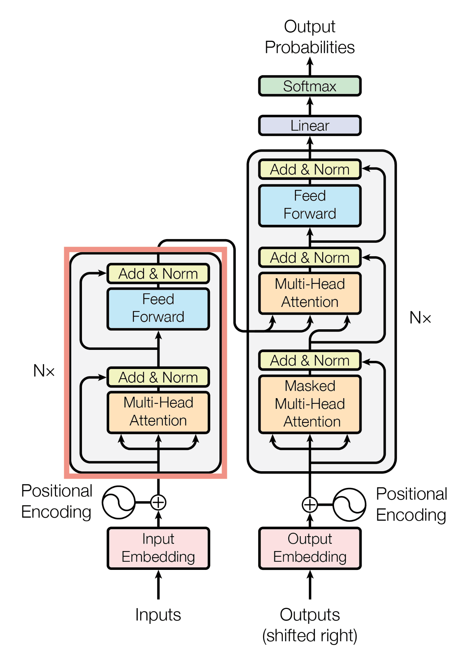
Transformer Model Architecture
The Transformer contains the following component:
Encoder
Decoder
Consists of
Stacked self-attention
Fully connected layers

Slide 18
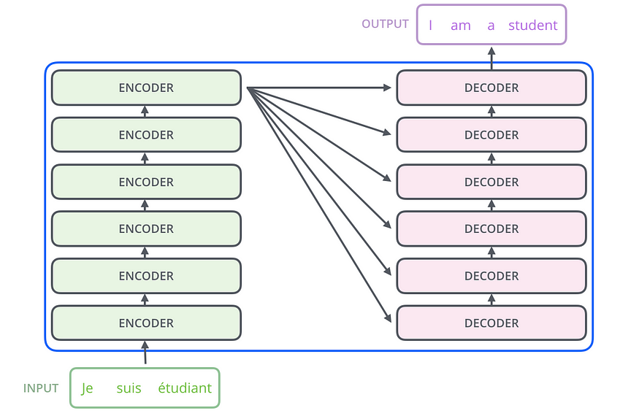
Transformer Model Architecture
towardsdatascience.com

Slide 19
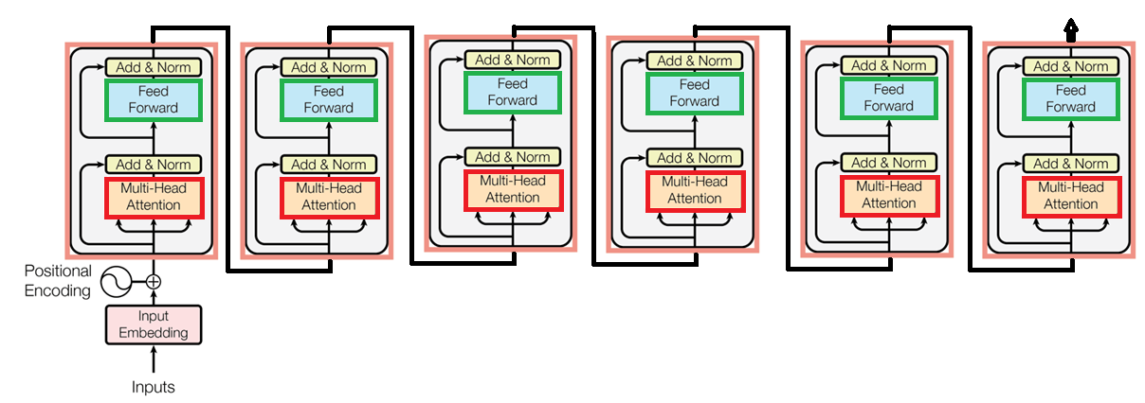
Encoder

Slide 20
Transformer Model Architecture
Input embeddings:
Input embedding refers to the process of converting raw input data, such as words or tokens in a sequence, into numerical representations called embeddings.
Dense vector representations
Continuous-valued vectors
Typically of fixed length and are represented by floating-point numbers
So that can be processed by a machine learning model.
Help capture the semantic meaning of the tokens in the input sequence. Why?
These embeddings can be learned during training or obtained from pre-trained word embeddings.

Slide 21
Transformer Model Architecture
Input embeddings:
Various techniques can be employed to efficiently capture the semantic meaning of tokens in the input sequence.
Some State-of-the-art methods:
Learned Word Embeddings: Train a neural network
Pre-trained Word Embeddings: Models like Word2Vec, GloVe, and FastText provide pre-trained word embeddings trained on large text corpora.
Contextual Word Embeddings: Employee models like ELMo (Embeddings from Language Models) and BERT
Fine-tuning large pre-trained language models on downstream tasks or by extracting features from the hidden layers of these models..

Slide 22
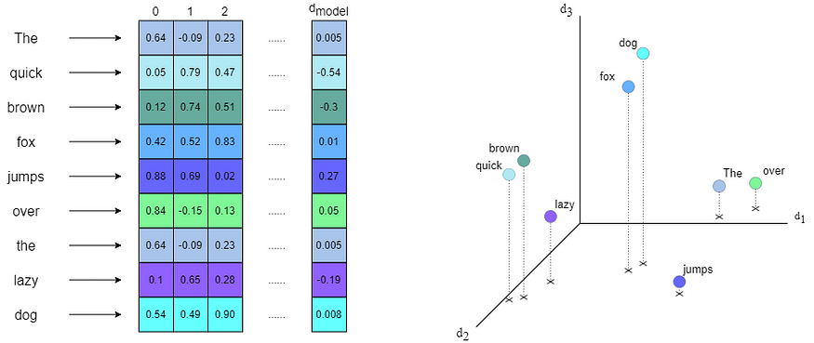
Transformer Model Architecture

Slide 23
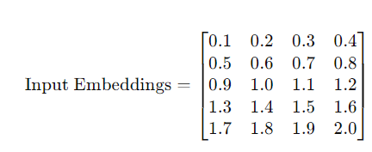
Transformer Model Architecture
Example:
Rows: Sequence Length
Columns: Word Embeddings for each word

Slide 24
Transformer Model Architecture
Positional encoding:
Transformer has no recurrence and no convolution, but the order of tokens is required.
Positional encoding incorporates the location or positional information of tokens in the input sequence.
Each position is assigned a unique representation
It provides the model with information about the token's position within the sequence.
The positional encodings have the same dimension d_{model} as the input embeddings

Slide 25
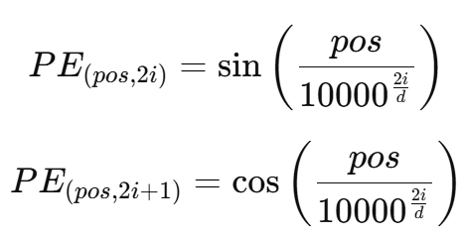
Transformer Model Architecture
Positional encoding:
There are many choices of positional encodings, learned and fixed.
Transformer paper used sine and cosine functions of different frequencies:
where pos is the position and i is the dimension

Slide 26
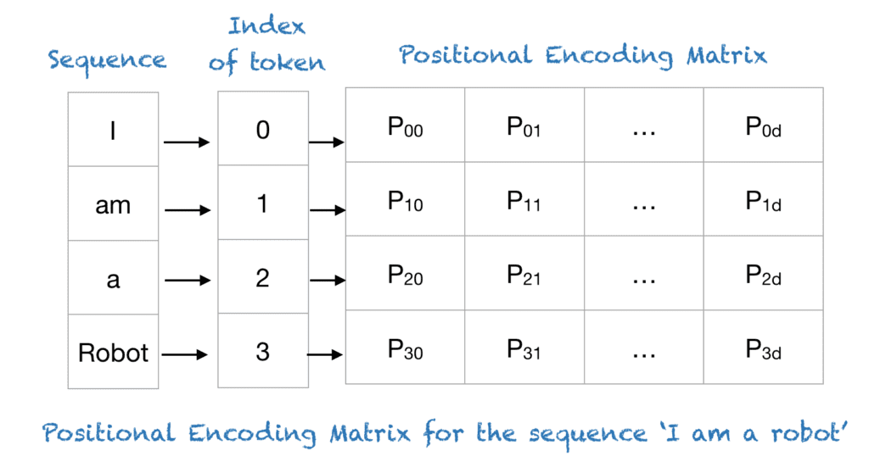
Transformer Model Architecture
machinelearningmastery.com

Slide 27
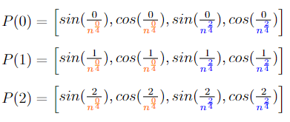
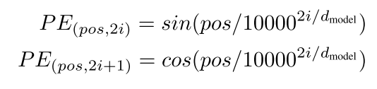
Transformer Model Architecture
medium.com

Slide 28

Positional Embedding
https://medium.com/

Slide 29
Thank You ☺

